Slide 1
Design of Inverter-Based Ring Oscillators
Chapter 3 Razavi PLL
Presented by Deepa Kulkarni
Guided by Neeraj Mishra, BITS Pilani

Slide 2
Presentation Topics
Phase Noise in Ring Oscillators
Preliminary Design Ideas
Obtaining the Desired Oscillation Frequency – 4 techniques
Four 2-GHz oscillator designs.
Frequency tuning
Continuous and discrete tuning
Tuning by Variable resistance
Tuning by Variable Capacitance
Discrete tuning
Problem of Supply noise: LDO and Current regulation

Slide 3

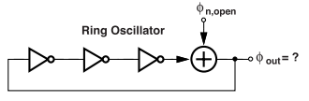
Phase noise in Ring oscillators
Establish a relationship b/w Open & Closed loop phase noise of a Ring Osc
Open loop phase noise:
Each stage in the Delay Line corrupts the signal only once.
Φn = Φout ; no loop
Closed loop Phase noise:
Noise circulates in the loop and the signal is corrupted multiple times.
This accumulates jitter indefinitely.
Φn is not equal to Φout

Slide 4
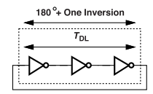
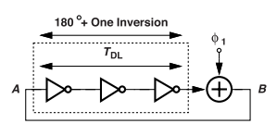
Open Loop and closed Loop Phase noise equations
Ring oscillator with a total delay of TDL
  Delay of one inverter = TD
  Total oscillation delay = Tosc = 6TD
  TDL has a phase shift of :
    2π (TDL / Tosc) = 180 degrees
    TDL = Tosc/2 = 1/(2f0) ;
Add a constant phase of φ1 :
  Phase shift has to be 180 degrees for oscillations
  Frequency Adjustment :
    2π (TDL / Tosc) + φ1 = π
    New freq of oscillation is : fosc = f0 − f0 * {φ1 / π}
    Freq of oscillation without added phase = f0
Osc Freq is dependent of the phase shift.
Gate delays TD do not change.
Notes:
1. How does the circuit understand to adjust the frequency?
New phase from delay stages=π−ϕ1 ; after the addition of phase
Total delay phase=2π⋅(TDL /Tosc) = π − ϕ1
???????????????Ask sir
2. How does TDL change?
TDL is constant if measured in seconds but changes if measured in degrees relative to the new oscillation frequency. Since TDL = T0/2 = 1/(2f0)
3. Why do the gate delays not change ?
Delay of each stage is dependent on inverter's strength and parasitic capacitances.

Slide 5
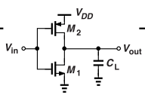
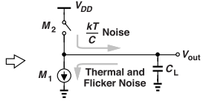
Noise sources in CMOS inverter
NMOS and PMOS produce : Thermal (white) noise and Flicker noise.
Falling edge in Vout is corrupted.
Noise from NMOS and PMOS is injected into the capacitance CL.
WORKING
NMOS (M1) injects:
  Thermal noise
  Flicker noise (1/f)
PMOS (M2) turns off suddenly:
  Leaves kT/C noise on load capacitor CL
  These noise sources corrupt the output edge,
  causing timing jitter → which translates to phase noise in oscillation.
Notes:
Why does only NMOS contribute to noise ?
Electrons are fast-moving and in PMOS holes are major charge carriers ; they move slow
When the Vin -> VDD, M2 turns off hence PMOS contributes less to noise than NMOS
2. Where does the kT/C noise come from?
When Vin → VDD, M2 turns off (acts like a switch opening).
The channel thermal noise just before cutoff is "frozen" onto CL
The random voltage left behind is:
Vnoise^2=kT/CL
This causes a random displacement in the falling edge of Vout → adds phase jitter.

Slide 6


Phase Noise in CMOS Inverter Oscillators
Analysis result in N stage ring oscillator:
  White noise :
  Flicker noise :
  To be observed:
White noise PN :
  Independent of Number of stages (N) & Capacitance CL
  Improved by higher ID, VDD, and lower VTH
Flicker Noise Phase Noise :
  Dependent inversely on CL(Nmos & Pmos) but independent of N.
  Improved by higher ID, more stages N
Assumptions:
gm,N = gm,P
IDN = IDP
Vthn = |Vthp|
Phase noise of N-stage Ring Oscillator calculated using Phase noise of 1 inverter
Notes:
Offset frequency = f

Slide 7
Effects of Variations in the width on PN
If we double the widths of all the transistor;
Oscillator frequency remains Same
  Capacitance is increased; Strength is increased ; Delay/stage is Same
Phase Noise :
  White noise is Halved
    Since, gm and ID doubles --> Noise current doubles
  Flicker noise is Halved
    Gate area increases
  Greater width translates to lower phase noise
  Phase noise decreases --> Power consumption increases

Slide 8
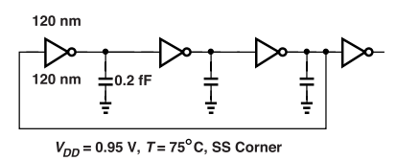
Preliminary Design Ideas
Initial design :
  3-stage ring oscillator
  Minimum-size devices {W/L = 120nm/ 40nm} & VDD= 1V
  Results :
    ~45GHz (very high and ideal conditions)
    No full swings (due to fast feedback).
  Problem with the design:
    Doesn't include interconnect capacitances,
    buffer load & Worse PVT case.
Worst case Scenario:
  Interconnect CL=0.2 fF ; Buffer (fanout = 1)
  VDD = 0.95V, T = 75°C, SS corner {slow VDD, High Temp}
  Results: Frequency drops to ~21 GHz

Slide 9
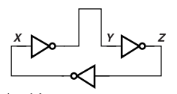
Simulations Done for Worse-case :
Improved Layout
Reduces wire capacitance between last and first inverter.
Equalizes delays by symmetrical layout + wires
Strengthened PMOS
  PMOS is doubled ;
  Drive current is increased.
  PMOS charges the load capacitance CL faster.
  Better pull up {the voltage closer to VDD}
  Frequency increases to ~22.6 GHz
    The faster CL charge lowers the delay slightly

Slide 10
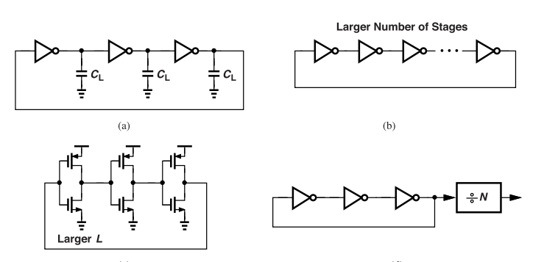
Obtaining the Desired Frequency
EX: Slowing Down the Ring Oscillator to 2 GHz
Add capacitance to each node.
Increase the number of stages.
Increase the length of the transistors.
Divide the output frequency by a factor of 10 or 11.

Slide 11
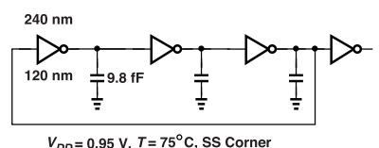
a. Add capacitance to each node.
Reduce oscillation frequency from 22.6 GHz → ~1.93 GHz
Capacitance per node : From 0.93 fF → ~10.5 fF
  increases gate delay → slows down oscillation.
Power consumption stays the same : P=3*f0*Ctot*(VDD^2)
  F0 decreases & Ctot increases = Nullify
Supply sensitivity Kvdd and Normalised value.
  KVdd decreases; lower absolute freq -> less sensitive in GHz/V terms.
  KVDD/f0 fairly remains the same.
b. Add capacitance to each node.
Increase inverters from N = 3 to 31 : Oscillations of 2.3Ghz with Sharper Edges
Each inverter still sees unity fanout → rise/fall times preserved.
Power is Independent of the stage count. P = {Ctot*(Vdd^2)}/2TD ; f0= 1/2NTD
KVdd and KVdd/f0 remain same.
Notes:
Capacitance and Time delay relation:
a capacitor with a larger capacitance stores more electrical energy, and therefore takes a longer time to charge or discharge to a certain voltage level.
2. What is Fanout ?
the maximum number of inputs that the output of a inverter can reliably drive without causing the inverter to malfunction.
3. what is KVDD?
Supply sensitivity or supply gain. GHz/V
Change in freq per volt change

Slide 12
C. Higher transistor lengths
Increase Length to L=240nm to obtain a freqency of ~2.5GHz
Increasing L weakens the Inverters : Less current drive; switching is slow
Input Capacitance rises due to gate area increase
Flicker noise decreases: due to larger channels have less Low-freq noise.
  Delay is proportional to L^2
Power consumption is reduced : weaker Inverters-> weaker IDD
Rounded peaks : due to weaker inverters : less pull.
d. Frequency division
Adding a 4th inverter to the o/p of the ring oscillator
This acts as a frequency divider/counter.
Counter consumes more power
No change in sensitivity or KVdd/f0 values
Notes:
Delay prop to L^2 : if L is increased by factor of m ; gate delay is by m^2

Slide 13
Phase Noise Considerations
We know that Power is inversely proportional to phase noise
And phase noise directly affects the oscillation frequency of the ring osc.
Example: Reducing Phase noise by 3dB (approx a factor of 2)
a) Adding identical oscillator outputs. Combined phase noise is HALVED.
b) Scaling up width and capacitances; scaling down R and L;
  Voltage swing & frequency (RC & LC don’t change) remains same.
  Phase noise is HALVED.
  You get lower phase noise but use more power.
Notes:
Adding Signals together :
The signals add constructively but the noise addition is random.
But since noise is uncorrelated, phase noise power increases only by 3 dB, while signal increases by 6 dB (voltage squared).
SNR improves, so phase noise reduces by 3 dB.
Scaling up the parameters :
Noise currents double (because thermal noise ∝ current or device size)
Impedance is halved → less noise voltage
Overall: Phase noise reduces by 3 dB (i.e., it is halved)

Slide 14
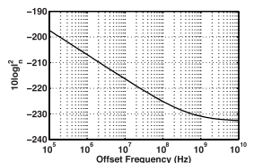
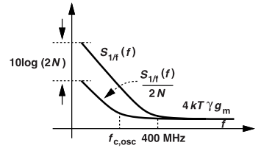

Transistor Noise Simulation
Transistor noise contributes to Phase noise :
  Thermal noise (is flat across freq range).
  Flicker noise (dominant at low freq; 1/f fall).
Flicker noise corner in Ring Osc.
  We have considered contributions of NMOS devices.
  Oscillator's flicker noise corner is LOWER than of a single transistor by a factor of 2N. { SI,NMOS = (1 / 2N) * S1/f,NMOS}
Figure of Merit
Offset : f at which the phase noise is defined.
We report 10logFOM
FOM improves as we go from the 1/f-noise regime (low f) to the white-noise regime (high f) as phase noise reduces.
Notes:
10logFOM = FOM value in dB
10 because FOM is an expression of power and not voltage

Slide 15
Four 2-GHz oscillator designs.
How do design ideas previously proposed affect phase noise and FOM?
First 2-GHz Oscillator Phase Noise : Adding CL.
  Frequency was reduced from 22.6GHz to 1.93Ghz
  Phase noise should fall by 10log(22.6GHz/ 1.93Ghz)^2 = 21.5 dB
  Power and Phase noise scale together
  FOM doesn’t change
Second 2-GHz Oscillator Phase Noise : Increase No of stages.
  Frequency was reduced from 22.6GHz to 2.3Ghz.
  Flicker noise has improved. : 10log(31/3) = 10dB.
  Comparing with (a) : 10 log(2.3 GHz/1.93 GHz)^2 = 0.8 dB
  Expecting a 9.2B reduction of Phase noise.
  FOM is improved as power consumption is independent of N.
It's better to increase the number of stages than to add capacitance.
Notes:
The square is there because phase noise increases with frequency squared

Slide 16

c) Third 2-GHz Oscillator Phase Noise : Longer Length
  Weaker Inverters => low power due to less node capacitances.
  Obtained a frequency of ~2.5GHz.
  Phase noise is slightly higher than the increasing no. Of stages.
  FOM is the highest : by 3-dB
  Best phase noise-to-power ratio.
d) Fourth 2-GHz Oscillator Phase Noise : Use of frequency divider.
  O/p frequency is divided by M
  Phase is divided by M
  Phase noise is lower by a factor of M : 20log₁₀(M) in dB
  No change in FOM
  No change in jitter as the divider o/p is also displaced by the same amt.
  Best solution is to increase the channel lengths of the transistors
  Next best is to increase the No of inverters
Notes:
FOM remains the because both noise and frequency scale proportionally with M.

Slide 17
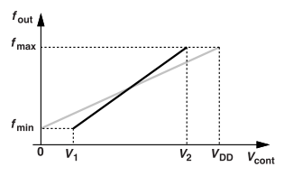
Frequency tuning
Develop methods for tuning frequencies for the inverter-based ring oscillator
Tuning Considerations:
Tuning frequency range:
  Wide enough to cover both PVT variations & desired frequency range.
VCO gain KVCO.
  KVCO (Hz/v) makes VCO sensitive to noise on control line.
  A high value of Kvco is not desired as it indicates more freq change in shorter voltage control range. KVCO must be low
  A wide voltage control range allows us to keep lower KVCO.
Rule of thumb: We keep KVCO below rough 0.1fm Hz/V
where ; fm=(fmax + fmin)/2

Slide 18
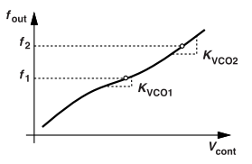
3. Linearity of tuning
  ​How much is the slope of KVCO varies?
  KVCO should vary by no more than 20% across the range.
  F1 changes to f2 : Expect KVCO2 to change not more than 20% of KVCO1
4. Constant Internal voltage swing.
  Prefer to keep the osc internal voltage swings constant across tuning range ; To avoid degrading the phase noise.
  Amplitude changes leak into phase noise. AM to PM conversion is min.
5. Stable Phase noise across range.
  Phase noise shouldn’t change significantly as freq is tuned.
Notes:
What happens if KVCO varies a lot?
A non-linear KVCO complicates filter tuning
PLL bandwidth and stability depend on KVCO. -> unstable behavior or poor lock performance.
A 20% max variation in KVCO ensures: Predictable loop behavior and less distortion.

Slide 19
Continuous and Discrete tuning
Larger frequency range make VCOs sensitive to noise on its control line.
Two types: Analog-continuous tuning and Digital –discrete tuning.
IDEA :
  Choose a path controlled by Weak Vcont; to lower the Kvco and use digital control to jump across frequency bands to precisely control the tuning.
  This is to get both low phase noise and wide tuning range.
1. Continuous tuning : Varies freq using Vcont (variable resistance)
  Limited range to keep Kvco low.
2. Discrete tuning : selects b/w the freq band.
  By switching capacitors on/off.
3. Together : Analog covers a small freq range for each digital setting, and the digital shifts the entire analog tuning curve into bits (1s and 0s).
Notes:
WHy is the idea so specific?
Design a low-Kvco analog path to reduce noise sensitivity, and use digital control to jump across frequency bands. This strategy gives low phase noise and wide, controllable tuning range.

Slide 20
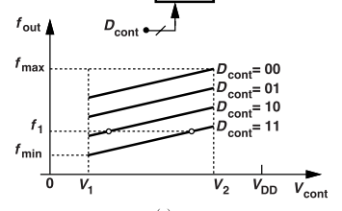

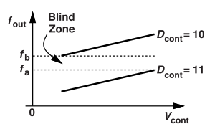
Vcont varies : [v1, v2] : small voltage range
Entire Frequency range is utilized.
Blind Zone
If two adjacent curves do not overlap,
VCO fails to cover certain frequencies.
Rule of Thumb:
Set VCO to cover 10% to 20% of center frequency.
Choose no of steps for digital tuning to cover the full range.
Increase the steps if KVCO is high.

Slide 21
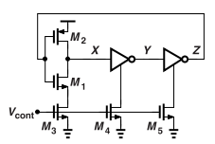

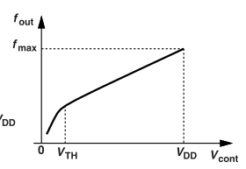
Tuning by Variable Resistance
NMOS-based Variable resistance :
M3-M5 : Voltage dependent resistors
As Vcont : [VDD--> 0]
  At Vcont=VDD ; NMOS are shorted giving zero resistance and high freq.
  As Vcont decreases, pull-down strength of inverters decrease.
  At Vcont near to zero, M3 to M5 enter deep triode region.
  Resistance go very high ; On-resistance increases.
  Falling edge is slowed down.
Gate delay Increases leading to reduced Oscillation freq.
Problems??
a) Asymmetric Transitions
b) Non-linear tuning
Notes:
The inverter delay increases drastically
- Since, resistance if very high ; Output node discharges very slowly.

Slide 22
Problems?
Asymmetric Transitions :
  Falling edge is slowed down due to increased resistance.
  Rising edge remains the same.
  This creates higher Phase noise on one side. (on the falling edge)
  At lower frequencies, it increases phase noise further.
Non-linear tuning:
  When Vcont is near to zero, resistance increases sharply.
  This causes "sharp" drop in frequency. (as gate delay increases)
  At Vcont=0 ; no oscillations .
Notes:
Un-even rise and fall times cause timing-uncertainty = phase noise.
2) Why is this worse at lower frequencies.?
Inverter delay is longer → slower transitions
Fall time becomes even slower due to higher NMOS resistance (as Vcont ↓)
So, jitter accumulates more on the slow falling edge → more phase noise.

Slide 23
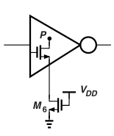
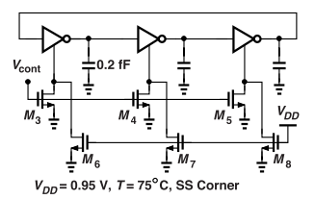

Solutions
Solving Non-linear tuning:
  M6 ,M7, M8 transistors are added in parallel to M3, M4, M5.
  Ensures a min pull-down path at Vcont=0; Thus, oscillations sustain.
    M6 to M8 never switch off ; connected to VDD.
    Provides a path to ground. O/p can still fall, and Oscillations sustain.
    M6 to M8 are weak ; provide fixed resistance.
    M3 to M5 are chosen strong maintain the maximum frequency.
  When Vcont = Vth ;
    M6 to M8 are in triode region.
    They "degenerate" NMOS in the inverter.
    This is increasing the NMOS (inverter) length.
    They act in series thus reducing Phase noise.
Notes:
1. Degeneration means adding resistance in series with a transistor to weaken its effective gain or strength.
2. Why Are M6–M8 Chosen Weak?
They are used as fixed resistance path and do not hinder thw fall time.
3. Why are M3-M5 chosen strong?
when Vcont = VDD, their resistance is very low → pull-down is fast → fall time is short → maximum frequency stays high.

Slide 24
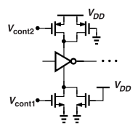
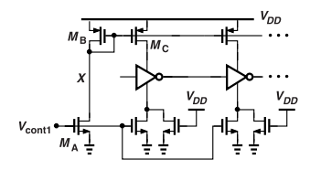
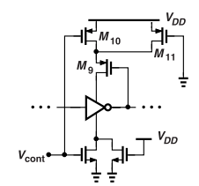
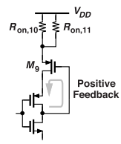
2. Symmetric tuning
Tune NMOS & PMOS strength for symmetric rise and fall.
Increase Vcont1 to weaken NMOS.
Decrease Vcont2 to weaken PMOS.
Using current mirror: get Vcont1--> invert it-->get Vcont2.
The inverting stage (Ma and Mb) add Phase noise.
Noise at node X corrupts the osc frequency.
Positive Feedback Tuning to reduce phase noise.
M9 PMOS as a feedback path. Controlled by Vcont through M10.
Vcont drops ; M10 PMOS turns more "ON".
M9 feedback strengthens and slows oscillator.
Achieves Symmetric Tuning

Slide 25
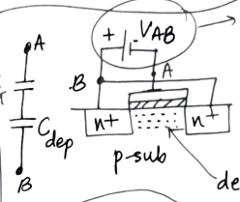
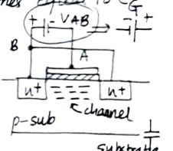
Tuning by Variable Capacitance
Continuous tuning by means of voltage-dependent capacitors, also called “varactors".
If Vab is negative:
  Electrons are repelled and form a depletion region.
  Cab = (Cg*Cdep)/ (Cg + Cdep) ;
If |Vab| decreases:
  Depletion region gets reduced.
  Capacitance increases = higher Cab.
If Vab is sufficiently positive:
  Channel of electrons forms
  Cab = Cg

Slide 26
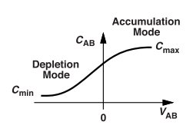

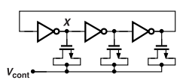
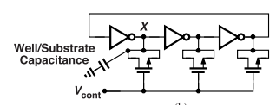
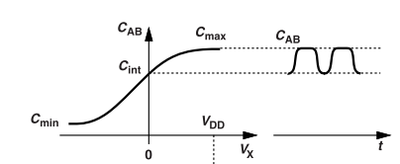
Modelling Varactor:
Integrating Varactors in Ring Oscillators
  Kvco>0 :
  Kvco<0:
Behavior:
  Vx swings from 0 to VDD
  Cab goes from Cint to Cmax.
  Cmin to Cint : not utilised as Vx can't be negative.
Tuning range is set by the varactor size
Advantages:
  Very low noise compared to transistor tuning

Slide 27
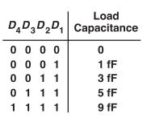
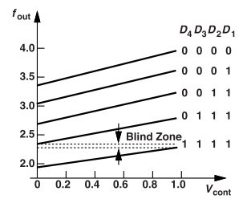
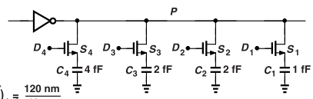
Discrete tuning
How is this implemented?
Add programmable capacitors at each node. { C1 to C4 }
The switches are driven by "thermometer" code.
As more switches are "on" : C increases and f decreases.
How to select Capacitance values?
C1: smallest ; C4: largest and C3=C2

Slide 28
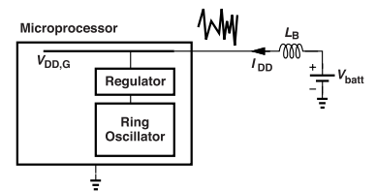
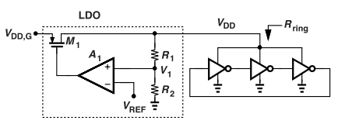
Problem of supply Noise
Ring osc. are sensitive to supply voltage
VDD noise modulates directly with frequency of osc and PN.
Use of a Regulator : to mitigate noise
Regulators o/p voltage is lower than the global VDD.
Parasitic Inductor LB current change translates to
large voltage change thus disturbing oscillator.
A. Voltage Regulation- LDO
LDO generates a stable VDD for ring Osc.
A1 ensures V1=Vref and VDD = Vref (1+R1/R2) is regulated.
LDO has good supply noise rejection and tunable output range
Notes:
LDO
⚠️ Drawbacks
Needs headroom → VDD is lower than global supply
LDO itself adds some noise, but manageable

Slide 29
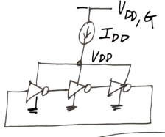
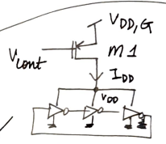
B . Current Regulation
  Isolate the ring osc from supply.
  Add a Current source in between.
  Idd consumes some voltage headroom.
  Vdd = Idd/(3*f0*Ctot)
  Change f0 using current
Noise in Vdd,g modules Vgs and IDD
M1 has flicker and thermal noise.
Vcont can't reach Vdd,g -> m1 off.
Using a current mirror gives worse tuning range and noise than LDO.

